Slide 1
Writing Linear Equations in Slope-Intercept Form
Chapter 5 Section 1

Slide 2
Slope-Intercept Form
Slope-Intercept form:
Where m=slope and b=y-intercept
y=mx+b

Slide 3
Writing Equation of a Line given Slope and Y-intercept
If you are given slope and y-intercept…plug them into the equation!
Example: m=2 and y-int=3
Then:

Slide 4
Examples:
1. m=-4 y-int=3
2. m=1/2 y-int=-5

Slide 5
Examples:
3. m=5/6 y-int: (0,-2)
4. m=0 y-int: (0,4)

Slide 6
Class Work
Complete Worksheet 5.1

Slide 7
Writing an Equation of a Line from a Graph
Use the graph to find the slope and y-intercept.
Plug the slope and y-intercept into the equation

Slide 8
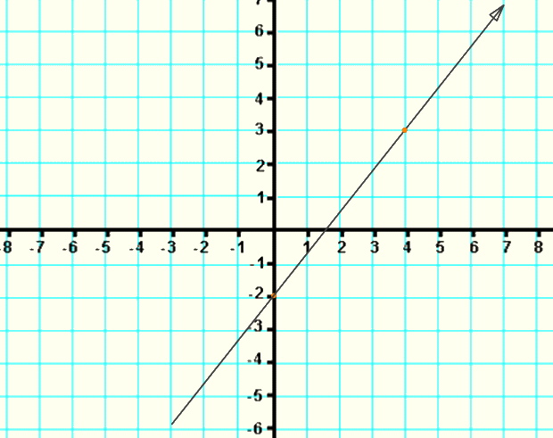
Example:
Find the slope
m=
Find the y-intercept
b=
Equation:
y= x+

Slide 9
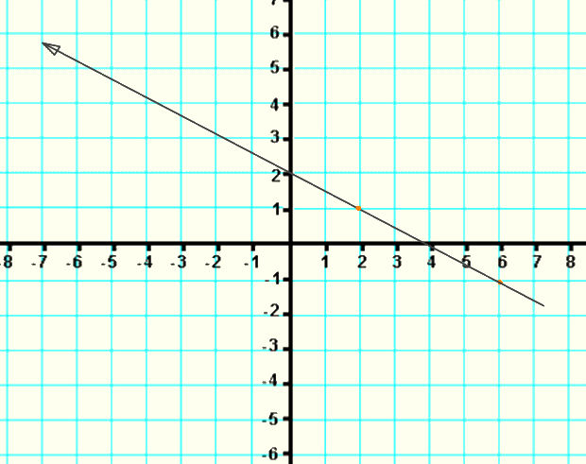
Example:
Find the slope
m=
Find the y-intercept
b=
Equation:
y= x+

Slide 10
Classwork
Worksheet 5.1 finish
Blue book- Page 147 # 1-4, 6
Pg 276 # 1-11, 26-27

Slide 11
Homework
Pg 276 # 12-23, 28, 29

